Slide 1
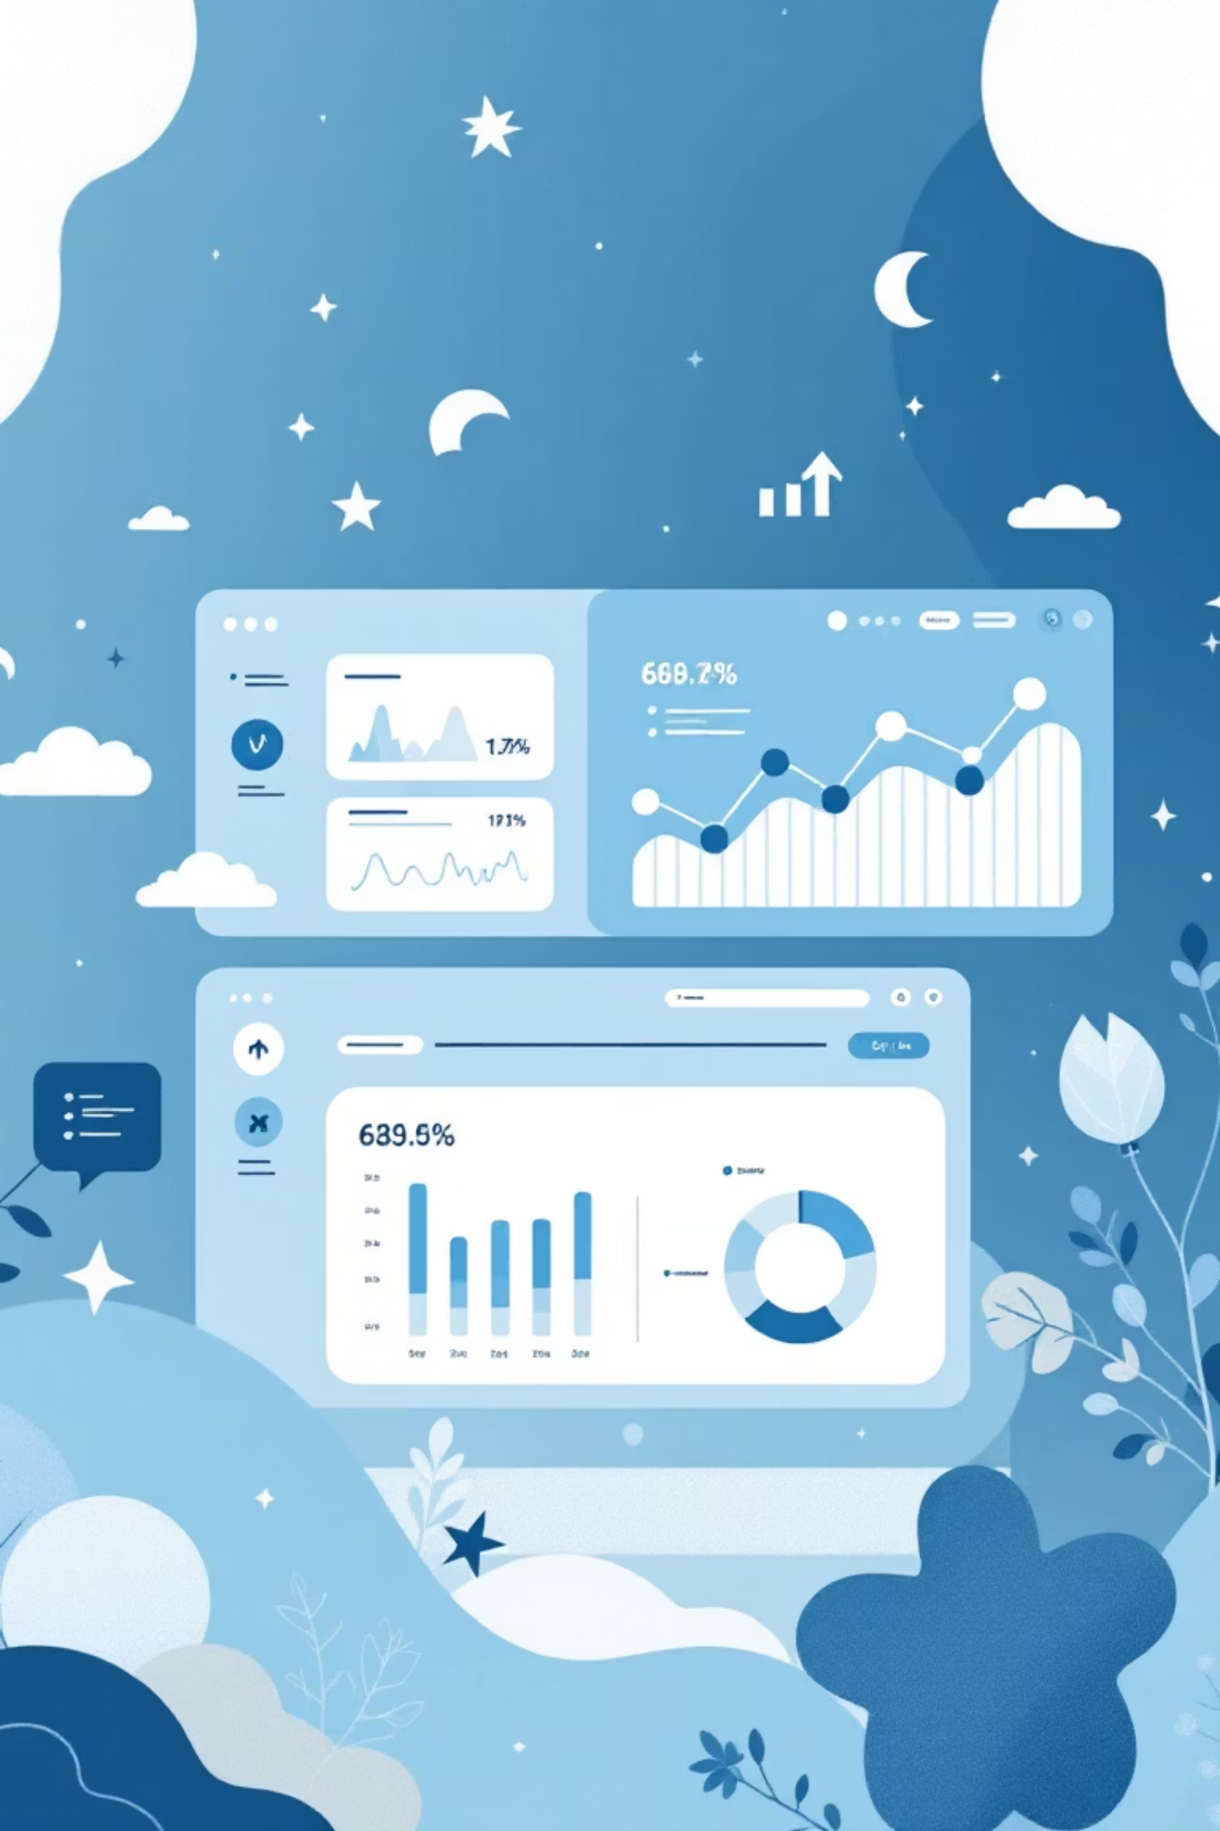
Customer Shopping Behavior Analysis
Uncovering insights from 3,900 purchases to drive strategic business decisions

Slide 2

Dataset Overview
3,900
18
50
Total Purchases
Data Columns
Locations
Transactions analyzed across all categories
Comprehensive customer and purchase attributes
Geographic diversity in customer base
25
Product Types
Wide variety of items purchased

Slide 3

Data Preparation Journey
01
Data Loading & Exploration
Imported dataset using pandas, analyzed structure with df.info() and summary statistics
02
Cleaning & Standardization
Handled 37 missing review ratings, renamed columns to snake_case format
03
Feature Engineering
Created age_group bins and purchase_frequency_days for deeper insights
04
Database Integration
Connected to PostgreSQL for advanced SQL analysis

Slide 4
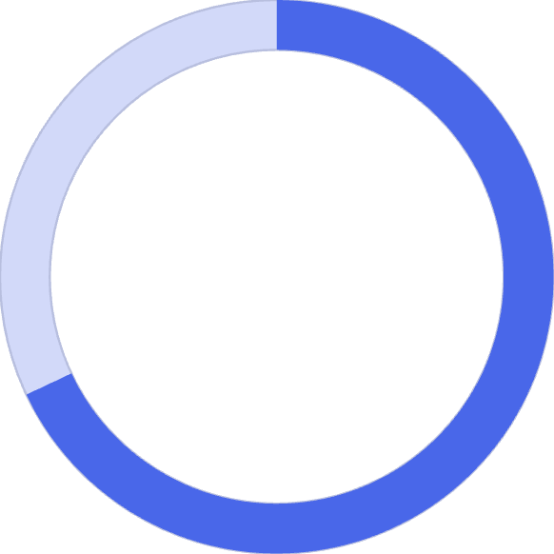
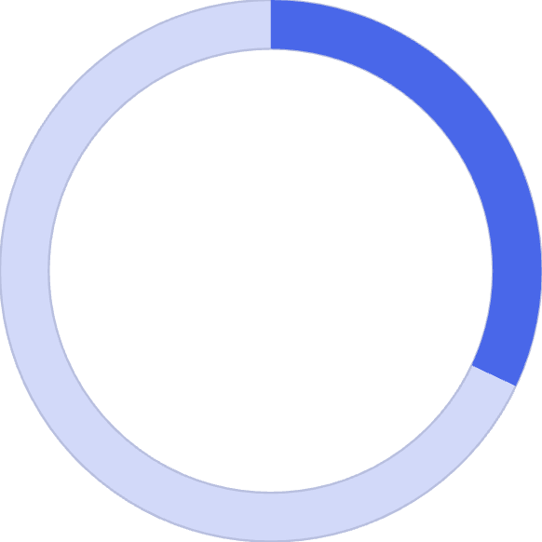
Revenue by Gender
Male customers drive majority of revenue, representing significant opportunity for targeted marketing campaigns.
68%
Male Customers
$157,890 total revenue
32%
Female Customers
$75,191 total revenue

Slide 5
Customer Segmentation Insights
Loyal Customers
Returning Buyers
New Customers
3,116 customers
701 customers
83 customers
Largest segment with consistent purchase history
Growing segment showing repeat interest
Fresh acquisition opportunities
Focus on converting returning buyers to loyal status through targeted engagement programs

Slide 6
Top-Rated Products
1
2
3
Gloves
Sandals
Boots
Average rating: 3.86
Average rating: 3.84
Average rating: 3.82
4
5
Hat
Skirt
Average rating: 3.80
Average rating: 3.78

Slide 7


Subscription Analysis
Subscribers
Key Finding: Similar spending patterns between groups, but massive untapped subscription potential with 73% non-subscribers
1,053 customers
$59.49 average spend
$62,645 total revenue
Non-Subscribers
2,847 customers
$59.87 average spend
$170,436 total revenue

Slide 8
Discount Strategy Insights
50%
49.66%
49.07%
Hat
Sneakers
Coat
Highest discount rate
48.17%
47.37%
Sweater
Pants
839 customers used discounts but spent above average—strategic pricing opportunity

Slide 9
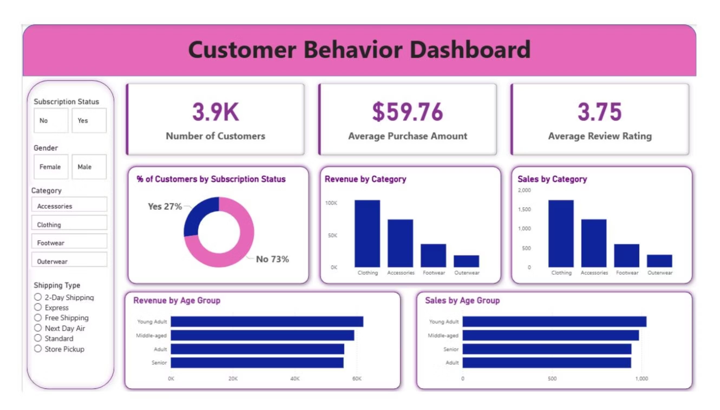

Slide 10
Power BI Dashboard
Interactive visualization bringing all insights together for real-time decision making

Slide 11

Strategic Recommendations
Boost Subscriptions
Loyalty Programs
Review Discounts
Promote exclusive benefits to convert 73% non-subscribers
Reward repeat buyers to grow loyal segment
Balance sales boosts with margin control
Product Positioning
Targeted Marketing
Highlight top-rated items in campaigns
Focus on high-revenue age groups and express shipping users

